Slide 1


Slide 2
Mark 1:1
“The beginning of the good news about Jesus the Messiah, the Son of God.”
Notes:
Good News = Gospel
About or of Jesus the Messiah, Jesus the Christ, the Son of God.
This isn’t the Gospel of Mark – it is the gospel according to Mark. Same Gospel, different perspective of who Jesus was and is.

Slide 3
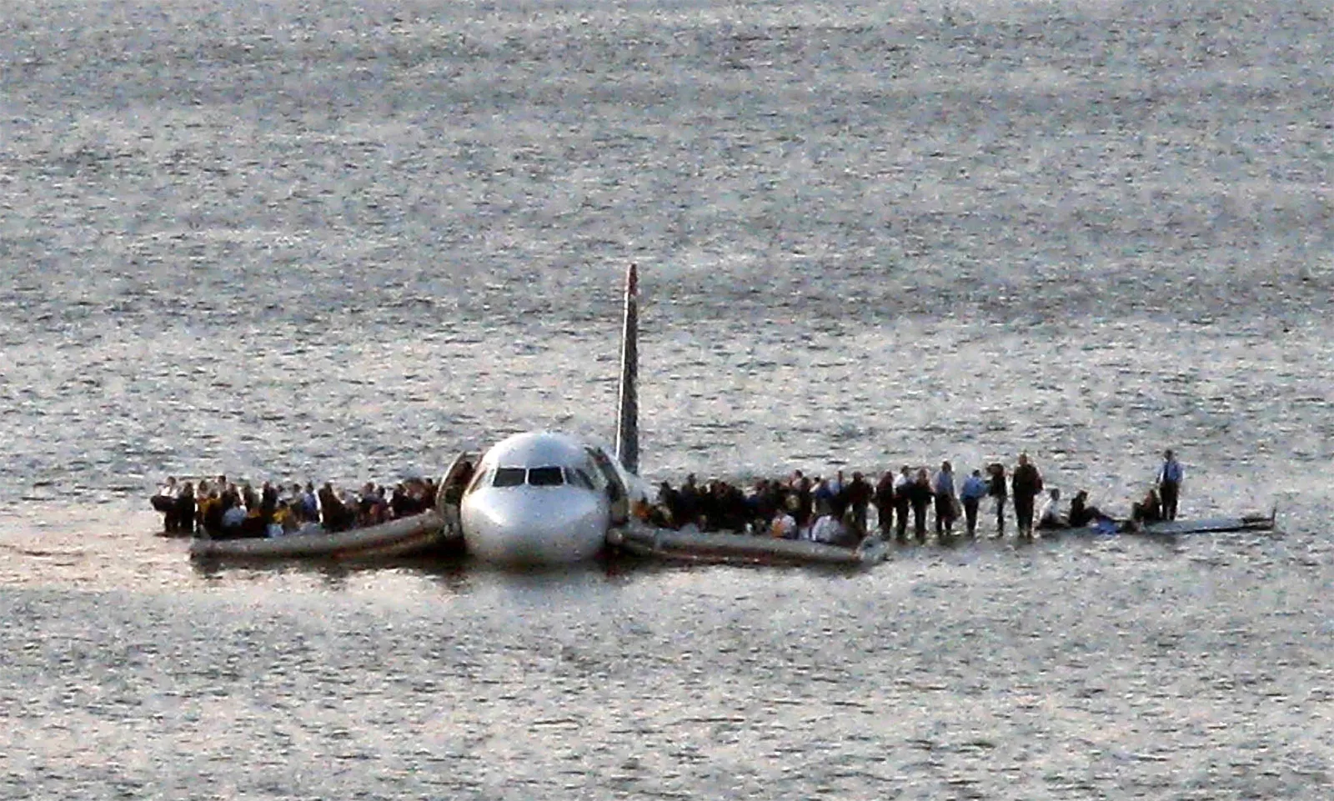
Notes:
Aviophobia – fear of flying. Sorry.
On January 15, 2009, Captain Chesley "Sully" Sullenberger safely landed US Airways Flight 1549 in the Hudson River, known as the "Miracle on the Hudson". After both engines were disabled by a bird strike shortly after takeoff from LaGuardia, Sully and First Officer Jeffrey Skiles glided the Airbus A320 to a safe water landing, saving all 155 people on board.
“I want to learn to fly” – ok, let’s start with a water landing just incase of emergencies…
A lot of us have been affected by the crash landings of marriages around us – today I want us to see the grace that Jesus shows to his followers even in difficult situations.

Slide 4
THE GOSPEL OF MARK · WEEK 33
Teach Me to Fly
Mark 10:1-12

Slide 5
Today
Teach Me to Fly
Mark 10:1-12
I. The Wrong Question
II. Hard Hearts
III. Intention over Permission

Slide 6
Mark 10:1-12
10 And he left there and went to the region of Judea and beyond the Jordan, and crowds gathered to him again. And again, as was his custom, he taught them.

Slide 7
Mark 10:1-12
² And Pharisees came up and in order to test him asked, “Is it lawful for a man to divorce his wife?” ³ He answered them, “What did Moses command you?” ⁴ They said, “Moses allowed a man to write a certificate of divorce and to send her away.”

Slide 8
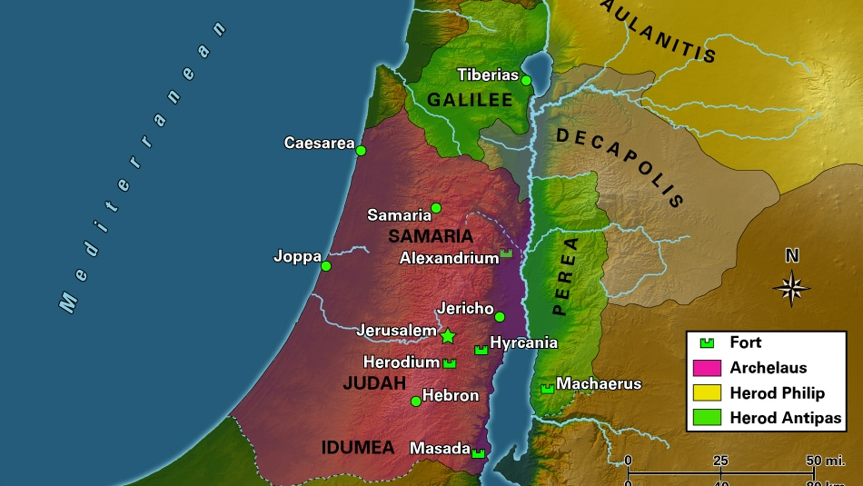
Notes:
Jesus is in Perea – Herod Antipas land – his cousin just got beheaded for confronting Herod about his divorce and remarriage.
This isn’t just a question. This could cost him his life if he isn’t careful here.

Slide 9
Mark 10:1-12
² And Pharisees came up and in order to test him asked, “Is it lawful for a man to divorce his wife?” ³ He answered them, “What did Moses command you?” ⁴ They said, “Moses allowed a man to write a certificate of divorce and to send her away.”

Slide 10

“You will not be successful in war if you train by the rules for beating a retreat. The same is true of marriage and divorce. The exceptional measures necessary when a marriage fails are of no help in discovering the meaning and intention of marriage.”
Edwards, J. R. (2002). The Gospel according to Mark
(p. 301). Grand Rapids, MI; Leicester, England: Eerdmans;
Apollos.
Notes:
Our question shouldn’t be is this sin or not, am I ok if I do this, the question is how do I have a marriage that flourishes! Teach me to fly, not how to crash.

Slide 11
Today
Teach Me to Fly
Mark 10:1-12
I. The Wrong Question
II. Hard Hearts
III. Intention over Permission

Slide 12
Mark 10:1-12
² And Pharisees came up and in order to test him asked, “Is it lawful for a man to divorce his wife?” ³ He answered them, “What did Moses command you?” ⁴ They said, “Moses allowed a man to write a certificate of divorce and to send her away.”

Slide 13
Deuteronomy 24:1
“When a man takes a wife and marries her, if then she finds no favor in his eyes because he has found some indecency in her, and he writes her a certificate of divorce and puts it in her hand and sends her out of his house…

Slide 14

The School of Shammai say: A man may not divorce his wife unless he has found unchastity in her, for it is written, “Because he hath found in her indecency in anything.” And the School of Hillel say: [He may divorce her] even if she spoiled a dish for him, for it is written, “Because he hath found in her indecency in anything.” R. Akiba says: Even if he found another fairer
than she, for it is written, “And it shall be if
she find no favour in his eyes.”
(Gittin, Mishnah. 9:10)

Slide 15
Mark 10:1-12
⁵ And Jesus said to them, “Because of your hardness of heart he wrote you this commandment.
Notes:
His opponents ask what is permissible; he points to what is commanded. Deut 24:1–3, he argues, is not a pretext for divorce but an attempt to limit its worst consequences for women.
This is a text of concession not a text of intention. The divine intention for marriage cannot be determined from a text about divorce.
Moses managed human failure; he didn't endorse it – if the worst happens, if you are about to crash, this is how you handle it. The diagnosis is hardness of heart — and that's a word for all of us, not just the divorced.

Slide 16
Did God really say…?
Notes:
In what ways do we try to split hairs of what God has said. This is approaching God with a posture of how close can I get to sinning without sinning. This is hardness of heart.

Slide 17
Mark 10:1-12
⁶ But from the beginning of creation, ‘God made them male and female.’ ⁷ ‘Therefore a man shall leave his father and mother and hold fast to his wife, ⁸ and the two shall become one flesh.’ So they are no longer two but one flesh. ⁹ What therefore God has joined together, let not man separate.”
Notes:
Analogia Scriptura – scripture rightly interprets scripture
Scribes and Pharisees are trying to figure out some deeper meaning of a text, one that will benefit them and destroy the lives of the women they have divorced, but Jesus declares the will of God as set forth in a creation text over against a legal text from Moses.
Creation was first! Then came the law.
We are trying to figure out the best way to crash land this thing, and Jesus is saying let’s look at how God intended it!

Slide 18
Today
Teach Me to Fly
Mark 10:1-12
I. The Wrong Question
II. Hard Hearts
III. Intention over Permission

Slide 19
1 Corinthians 10:23
²³ “All things are lawful,” but not all things are helpful. “All things are lawful,” but not all things build up.
Notes:
This is a call to discipleship. It is costly and countercultural. Just because I’m not sinning a lot doesn’t necessarily mean I’m a fully devoted follower of Jesus. It just means I’m a legalist.

Slide 20
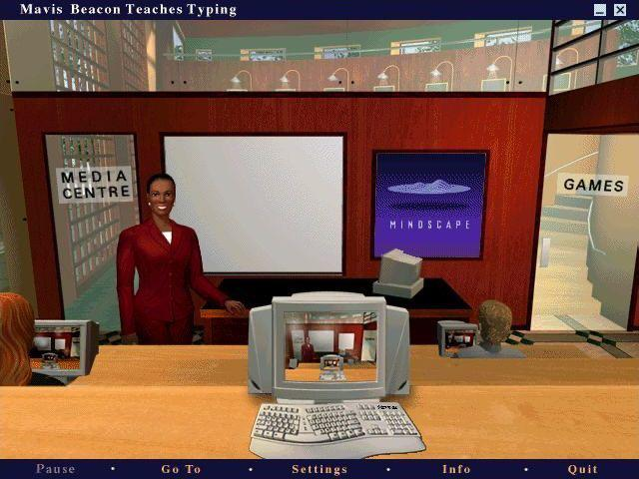
Notes:
I didn’t break the rules. No one said I couldn’t do that. It was lawful – but it didn’t help.
Or licencious – I can keep doing this because I’m not being punished for it, or my teachers will keep showing me grace and forgiving me so why not?

Slide 21
Mark 10:1-12
¹⁰ And in the house the disciples asked him again about this matter. ¹¹ And he said to them, “Whoever divorces his wife and marries another commits adultery against her, ¹² and if she divorces her husband and marries another, she commits adultery.”
Notes:
The intent of Jesus’ teaching is not to shackle those who fail in marriage with debilitating guilt. The question is not whether God forgives those who fail in marriage. The answer to that question is assured in 3:28, “ ‘All the sins and blasphemies of men will be forgiven.’ ”

Slide 22
There is, after all, no instance in Scripture of an individual seeking forgiveness and being denied it by God. The question in our day of impermanent commitments and casual divorce is whether we as Christians will hear the unique call of Christ to discipleship in marriage.
Edwards, J. R. (2002). The Gospel according to Mark (p. 305).
Grand Rapids, MI; Leicester, England: Eerdmans; Apollos.

Slide 23
In marriage, as in other areas to which the call of Christ applies, will we seek relief in what is permitted, or commit ourselves to what is intended by God and commanded by Christ? Will we fall away in trouble and difficulty (4:17), or follow Jesus in the costly journey of discipleship, even in marriage? Will we sunder the divine union of “two become one flesh,” or will we honor and nurture marriage as a gift and creation of God?
Edwards, J. R. (2002). The Gospel according to Mark (p. 305).
Grand Rapids, MI; Leicester, England: Eerdmans; Apollos.

Slide 24

“We cannot present a reason for Christ to finally close off his heart to his own sheep. No such reason exists. Every human friend has a limit. If we offend enough, if a relationship gets damaged enough, if we betray enough times, we are cast out. The walls go up. With Christ, our sins and weaknesses are the very resumé items that qualify us to approach him. Nothing but coming to him is required—first at conversion and a thousand times thereafter until we are with him upon death.”
Dane C. Ortlund, Gentle and Lowly: The Heart of Christ for
Sinners and Sufferers
Notes:
If you feel beat up this morning – it just means your resume is filled out. The only way we can approach Christ is when we acknowledge our sins and weaknesses.

Slide 25
Gospel Application
In what ways are you thinking about the crash rather than the flight?
Notes:
25

